Slide 1

OIL WELL pRODUCTION SYSTEM
DEVON eNeRGY CORPORATION
wEREWOLF

Slide 2
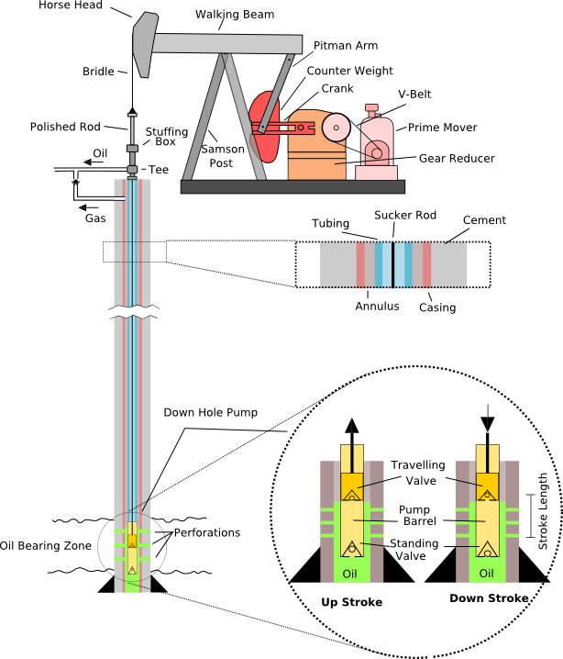
OIL WELL STATE
This Photo by Unknown author is licensed under CC BY-SA.
Well state is The efficient operation procedure

Slide 3
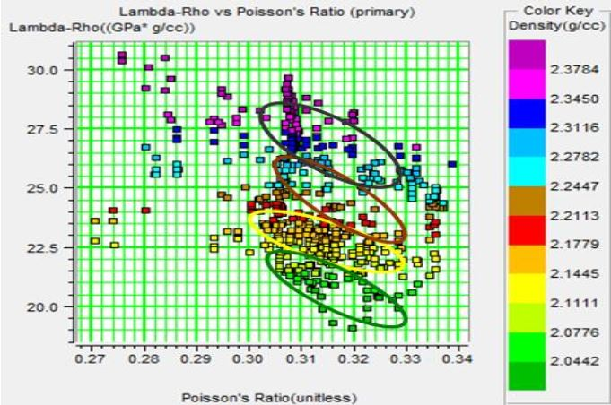
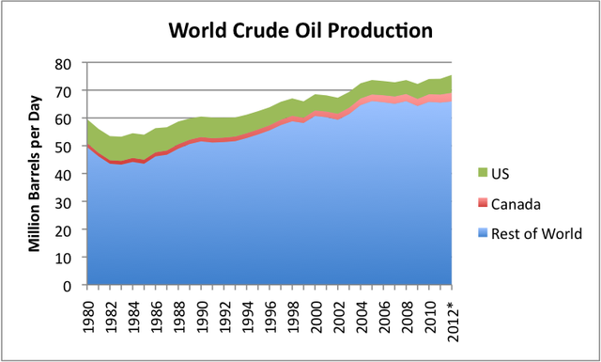
What happens when an oil well is not Functioning ?
Problems with oil well
No problems with oil well
This Photo by Unknown author is licensed under CC BY-SA.
This Photo by Unknown author is licensed under CC BY-SA.

Slide 4
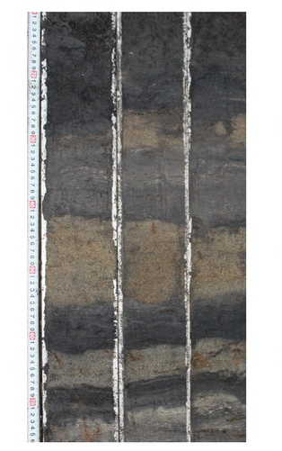
PROJECTED SOLUTION FOR OIL WELL PROBLEMS
Work on new construction of oil wells
Develop steps for soil mixing to reclaim soil
Layer the soil in a way tHat would grow trees for Fruits and medicinal purposes
And proliferate soil bacteria that produce oil
This Photo by Unknown author is licensed under CC BY-ND.

Slide 5
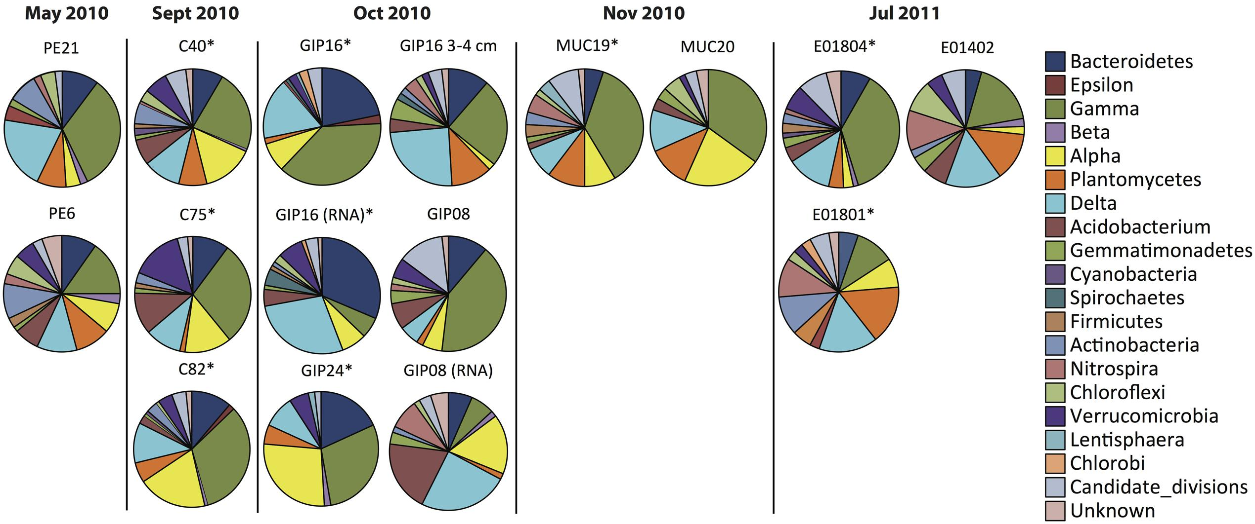
Oil sites that show bacteria
This Photo by Unknown author is licensed under CC BY.

Slide 6
TABLE 1. MICROORGANISM AND SEQUENCE
NAME | Sequence
Bacteroidetes (ovatus strain ATCC 8483) | atggcactta gatacgtcat taaaaaaaga acattcggct ttgataaaac taaagctgaa
Epsilon (proteobacterium isolate DGGE) | aatgggcgaa gcctgatgga gcacgccgcg tgcaggatga aggccttcgg gtcgtaaact
Gamma (Gemmataceae bacterium isolate CJuql4) | CONTIG join(CABFKD010000002.1:1..403716,gap
Beta (Arabidopsis thaliana chromosome) | /gene_synonym="ATTIM23-2; translocase inner membrane subunit 23-2"
Alpha (same as above) | (same as above)
Plantomycetes (same as above) | (same as above)
Delta (same as above) | (same as above)

Slide 7
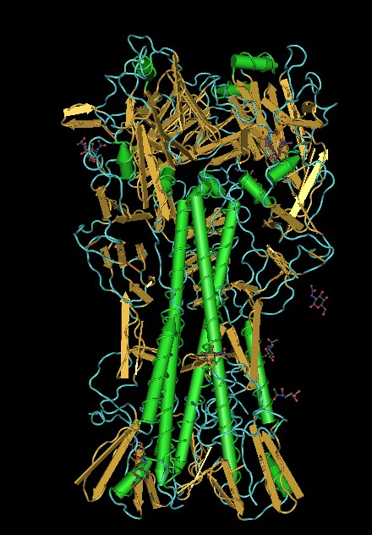
interactions
This Photo by Unknown author is licensed under CC BY-SA.

Slide 8

This type of biological clean-up is good for the environment
This Photo by Unknown author is licensed under CC BY-SA.

Slide 9
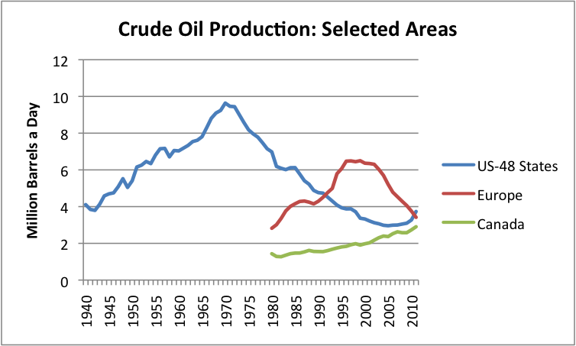
Oil well production data
This Photo by Unknown author is licensed under CC BY-SA.

Slide 10
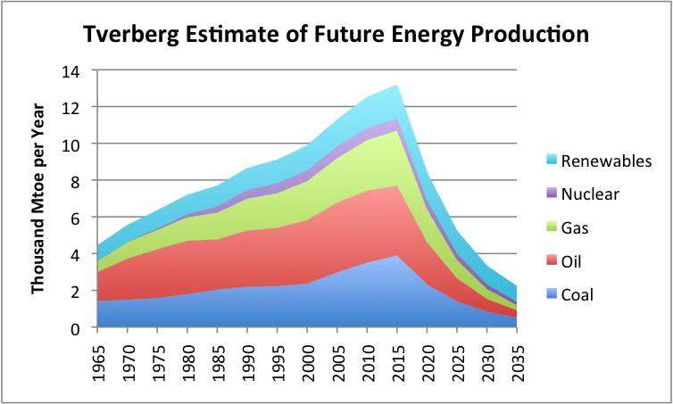
Slowed oil production
This Photo by Unknown author is licensed under CC BY-SA.

Slide 11
REFERENCES
Www.bing.com
Www.NCBI.com
Www.Genosys.com
Www.genbank.com

